Slide 1
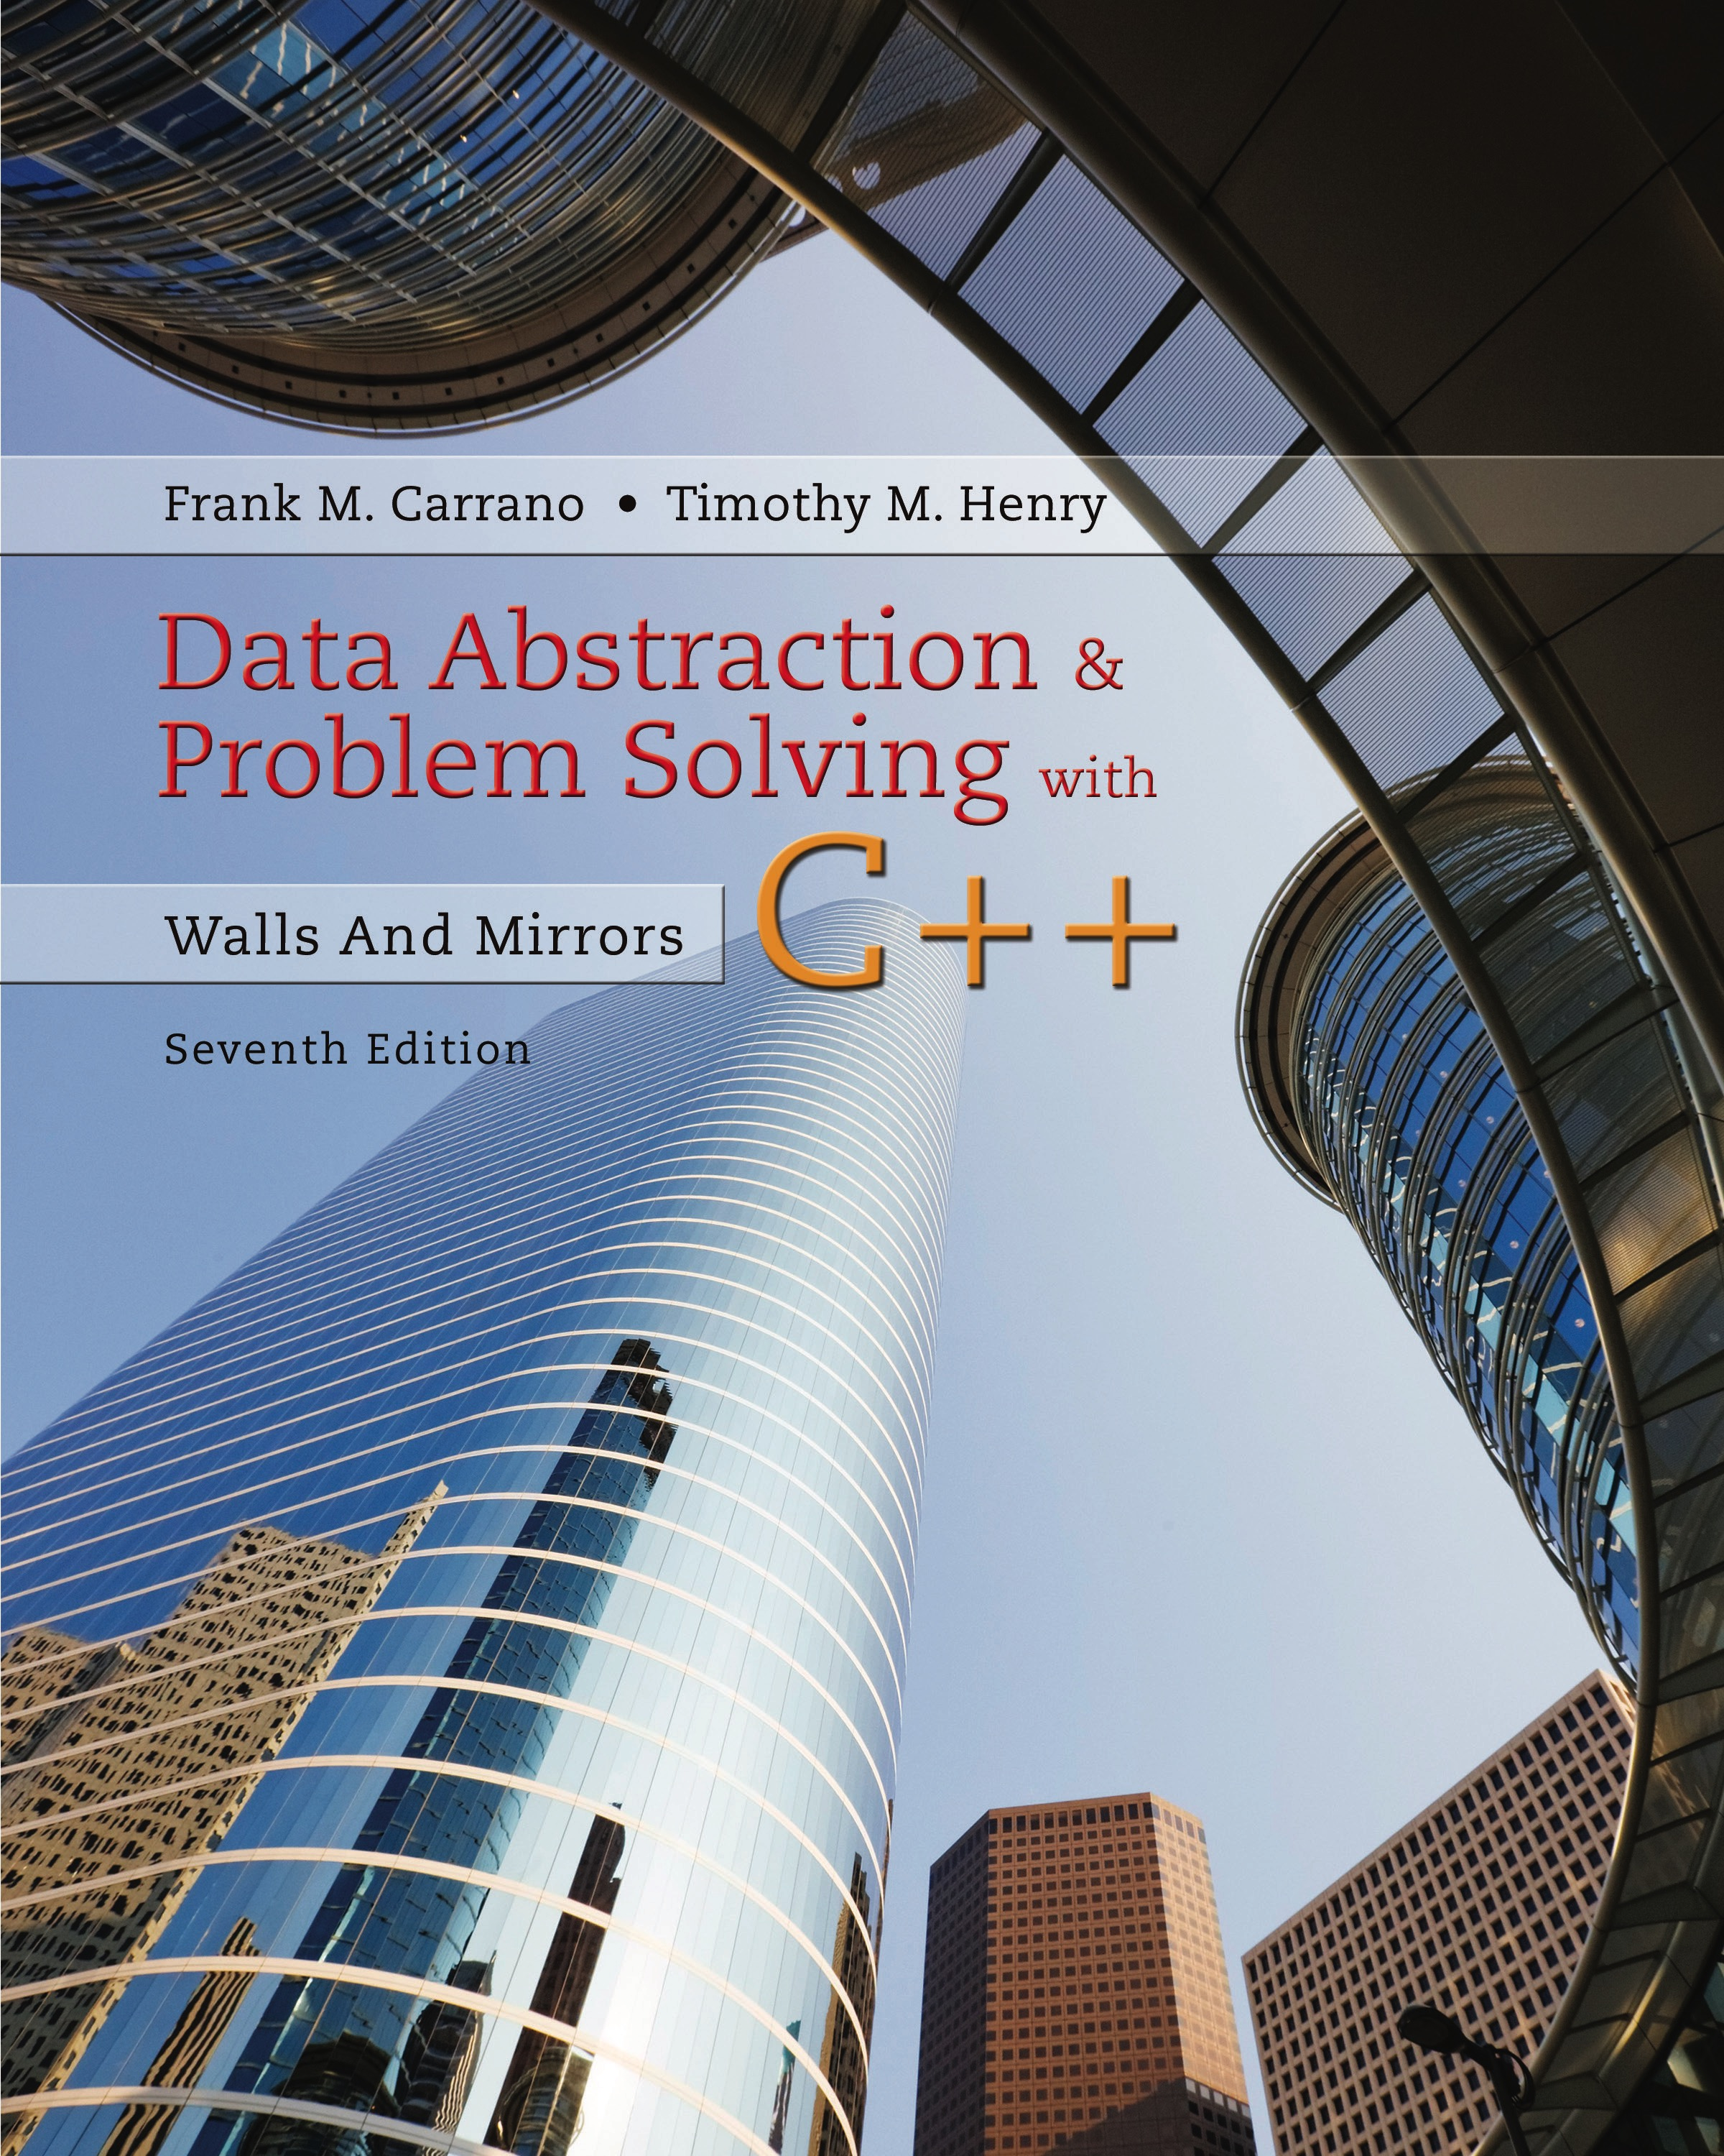
Data Abstraction & Problem Solving with C++: Walls and Mirrors
Seventh Edition
Chapter 17
Heaps
Copyright © 2017, 2013, 2007 Pearson Education, Inc. All Rights Reserved
Notes:
If this PowerPoint presentation contains mathematical equations, you may need to check that your computer has the following installed:
1) MathType Plugin
2) Math Player (free versions available)
3) NVDA Reader (free versions available)

Slide 2
The A D T Heap (1 of 6)
A heap is a complete binary tree that either is
Empty or …
Whose root contains a value
each of its children and has heaps as its subtrees
It is a special binary tree … different in that
It is ordered in a weaker sense
it will always be a complete binary tree

Slide 3
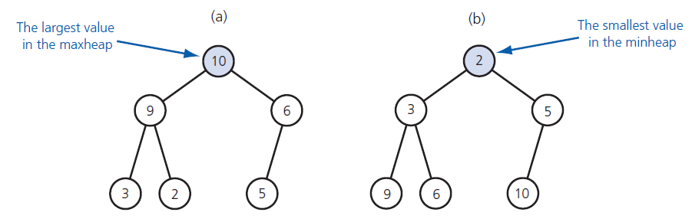
The A D T Heap (2 of 6)
Figure 17-1 (a) A maxheap and (b) a minheap

Slide 4
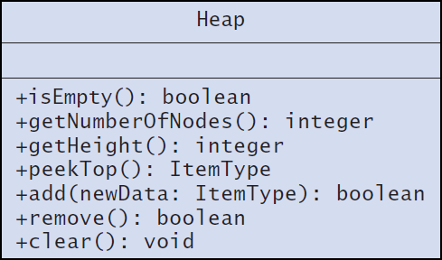
The A D T Heap (3 of 6)
Figure 17-2 U M L diagram for the class Heap

Slide 5
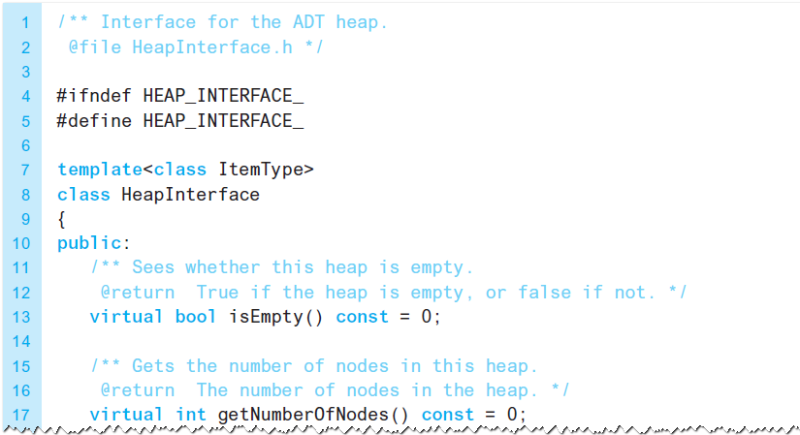
The A D T Heap (4 of 6)
Listing 17-1 An interface for the A D T heap

Slide 6
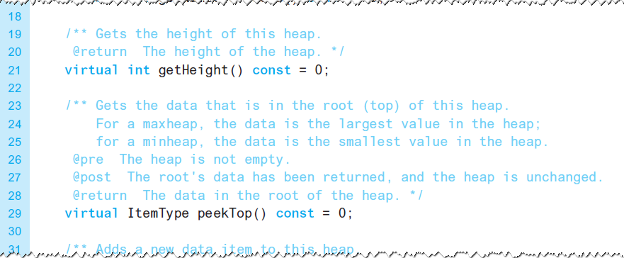
The A D T Heap (5 of 6)
Listing 17-1 [Continued]

Slide 7
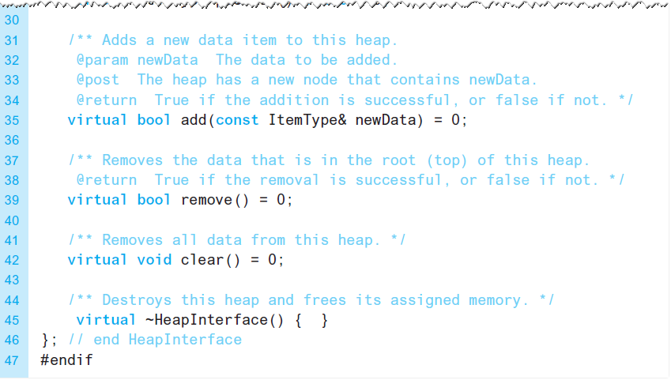
The A D T Heap (6 of 6)
Listing 17-1 [Continued]

Slide 8
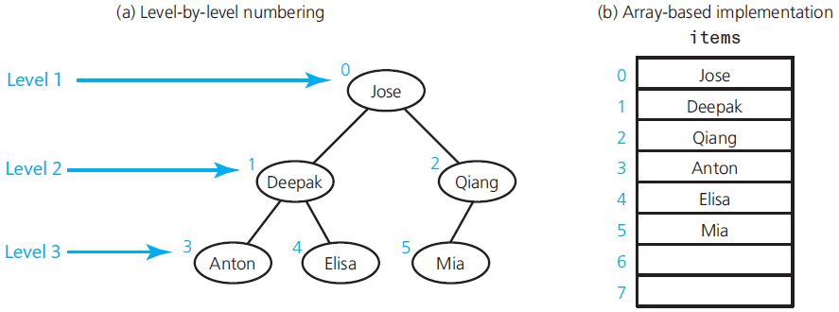
Array-Based Implementation of a Heap
Figure 17-3 A complete binary tree and its array-based implementation

Slide 9
Algorithms for Array-Based Heap Operations (1 of 8)
Assume following private data members
items: an array of heap items
itemCount: an integer equal to the number of items in the heap
maxItems: an integer equal to the maximum capacity of the heap

Slide 10
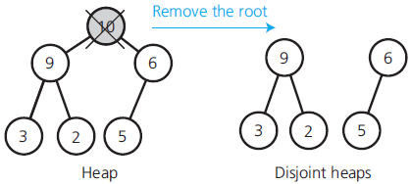
Algorithms for Array-Based Heap Operations (2 of 8)
Figure 17-4 Disjoint heaps after removing the heap’s root

Slide 11
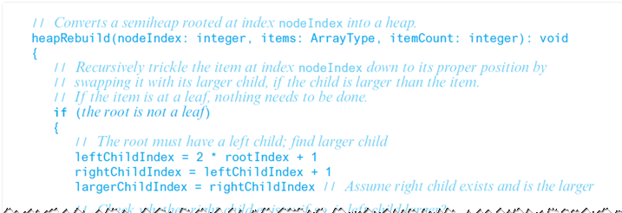
Algorithms for Array-Based Heap Operations (3 of 8)
Recursive algorithm to transform semiheap to heap.

Slide 12
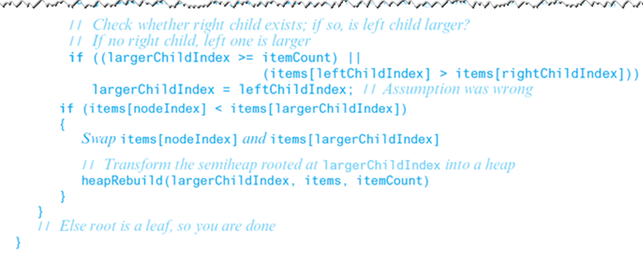
Algorithms for Array-Based Heap Operations (4 of 8)
Recursive algorithm to transform semiheap to heap.

Slide 13
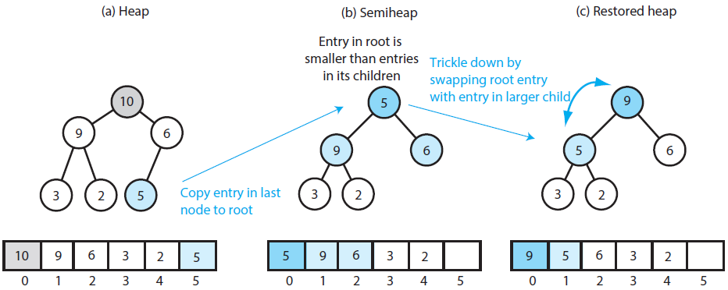
Algorithms for Array-Based Heap Operations (5 of 8)
Figure 17-5

Slide 14
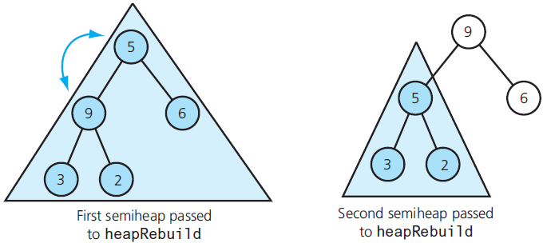
Algorithms for Array-Based Heap Operations (6 of 8)
Figure 17-6 Recursive calls to heapRebuild

Slide 15
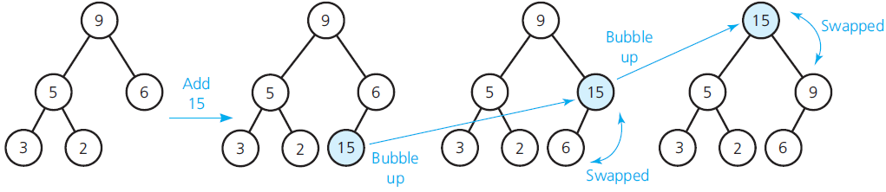
Algorithms for Array-Based Heap Operations (7 of 8)
Figure 17-7 Adding 15 to a heap

Slide 16
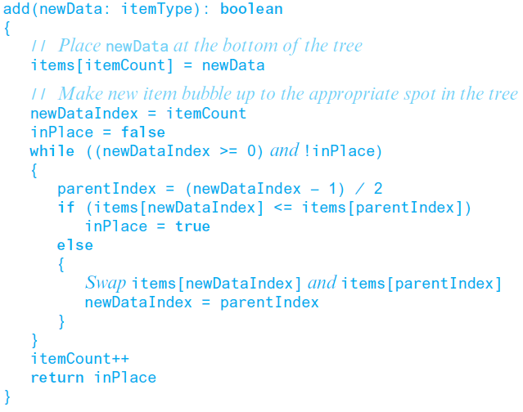
Algorithms for Array-Based Heap Operations (8 of 8)
Pseudocode for add

Slide 17
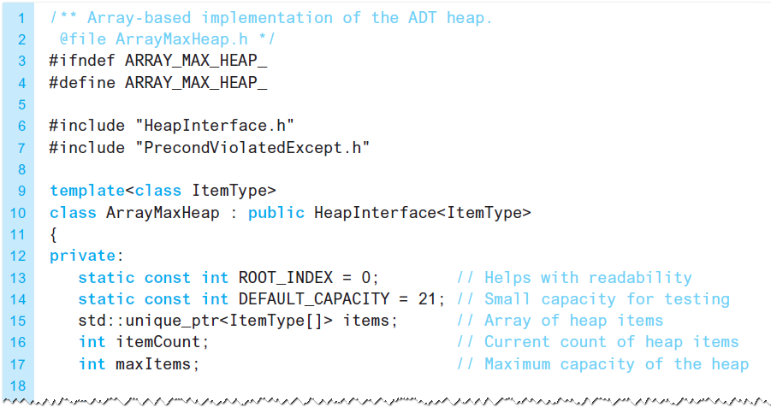
The Implementation (1 of 10)
Listing 17-2 The header file for the class ArrayMaxHeap

Slide 18
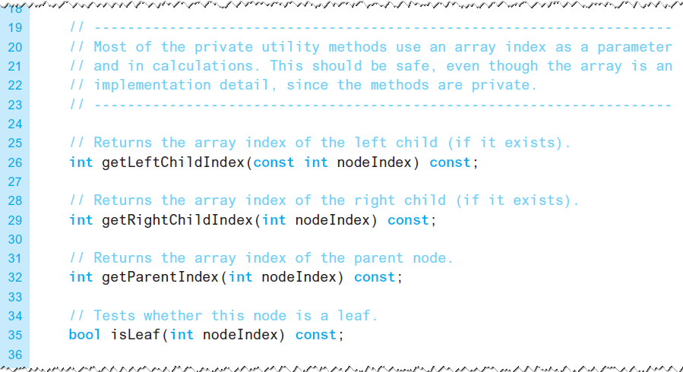
The Implementation (2 of 10)
Listing 17-2 [Continued]

Slide 19
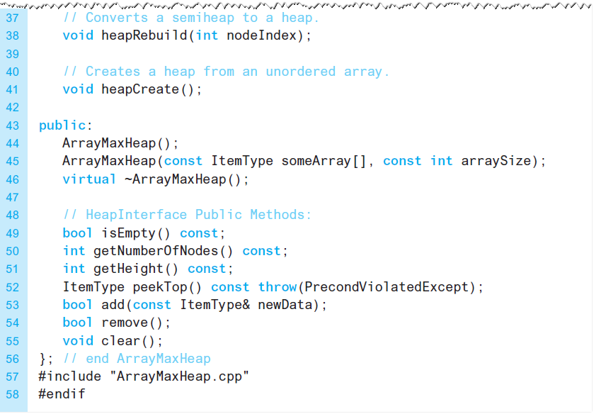
The Implementation (3 of 10)
Listing 17-2 [Continued]

Slide 20
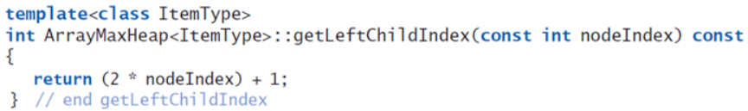
The Implementation (4 of 10)
Definition of method getLeftChildIndex

Slide 21
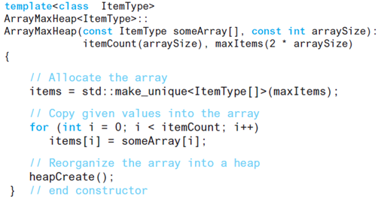
The Implementation (5 of 10)
Definition of the constructor

Slide 22
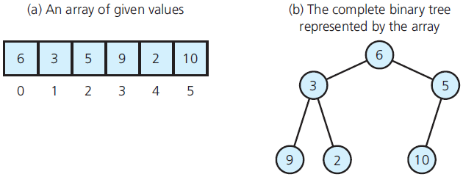
The Implementation (6 of 10)
Figure 17-8 Array and its corresponding complete binary tree

Slide 23
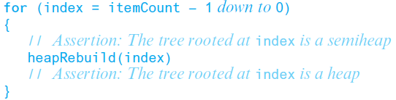
The Implementation (7 of 10)
Building a heap from an array of data

Slide 24
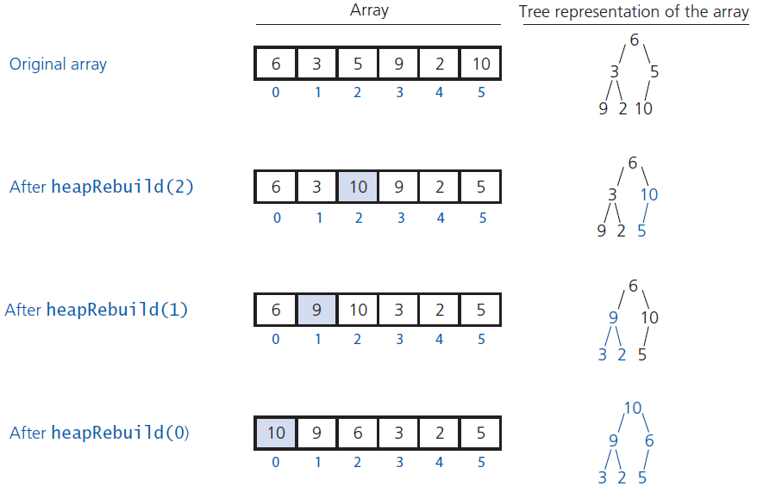
The Implementation (8 of 10)
Figure 17-9 Transforming an array into a heap

Slide 25
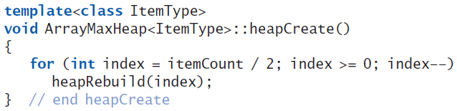
The Implementation (9 of 10)
C++ method heapCreate

Slide 26
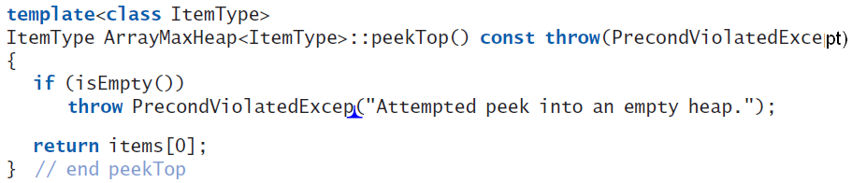
The Implementation (10 of 10)
C++ method peekTop which tests for an empty heap

Slide 27
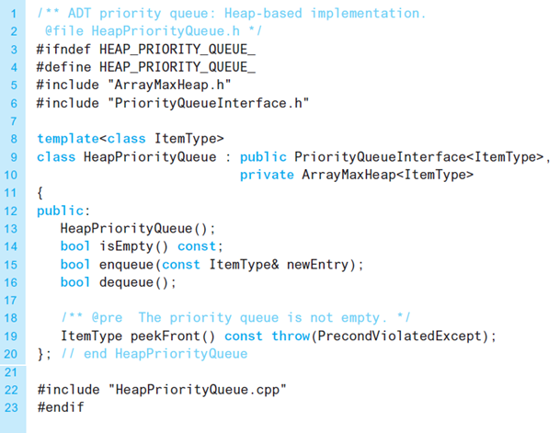
Heap Implementation of the A D T Priority Queue (1 of 4)
Listing 17-3 A header file for the class HeapPriorityQueue

Slide 28
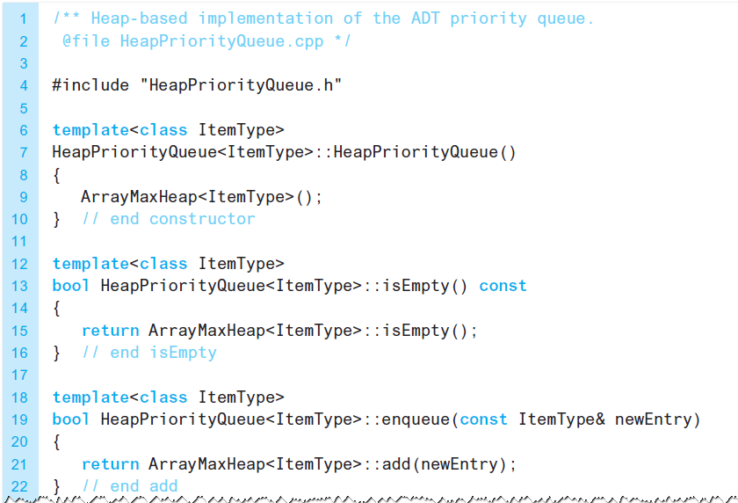
Heap Implementation of the A D T Priority Queue (2 of 4)
Listing 17-4 An implementation of the class HeapPriorityQueue

Slide 29
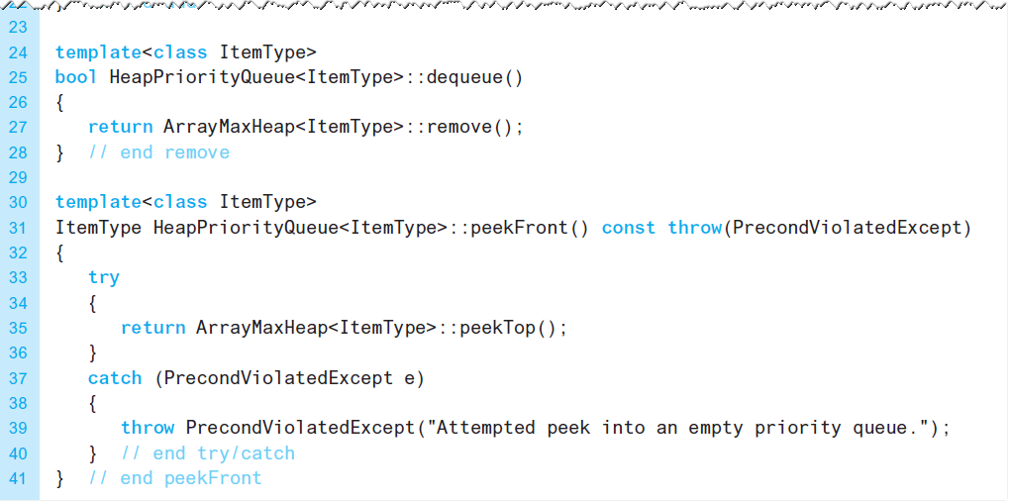
Heap Implementation of the A D T Priority Queue (3 of 4)
Listing 17-4 [Continued]

Slide 30
Heap Implementation of the A D T Priority Queue (4 of 4)
Heap versus a binary search tree
If you know maximum number of items in the priority queue, heap is the better implementation.
Finite, distinct priority values
Many items likely have same priority value
Place in same order as encountered

Slide 31
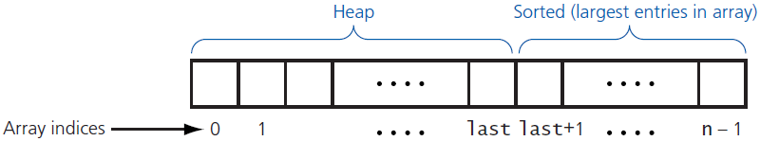
Heap Sort (1 of 4)
Figure 17-10 Heap sort partitions an array into two regions

Slide 32
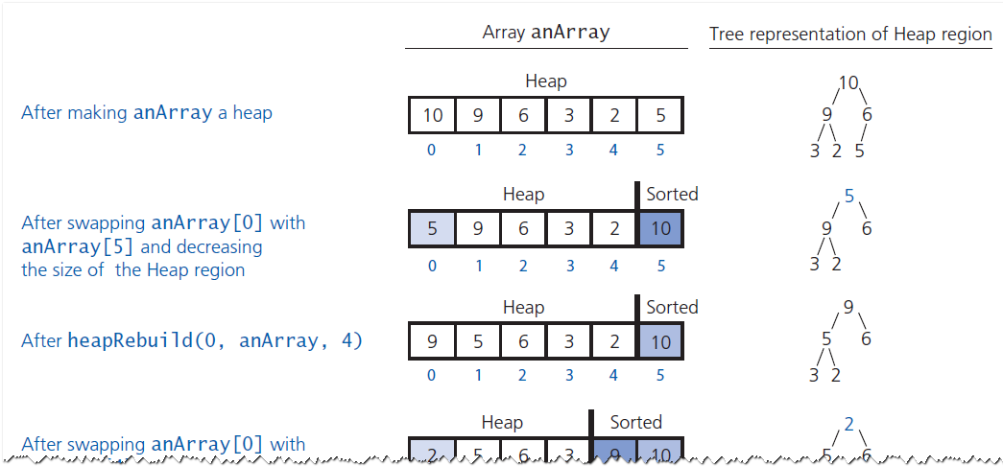
Heap Sort (2 of 4)
Figure 17-11 A trace of heap sort, beginning with the heap in Figure 17-9 (see slide 24)

Slide 33
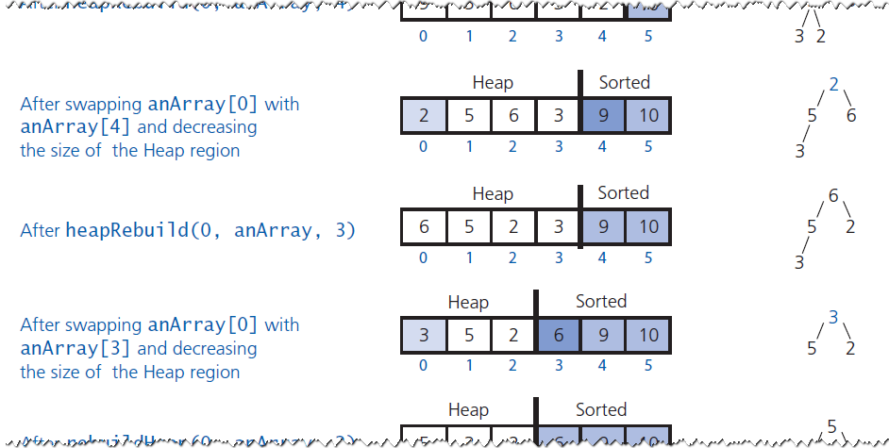
Heap Sort (3 of 4)
Figure 17-11 [Continued]

Slide 34
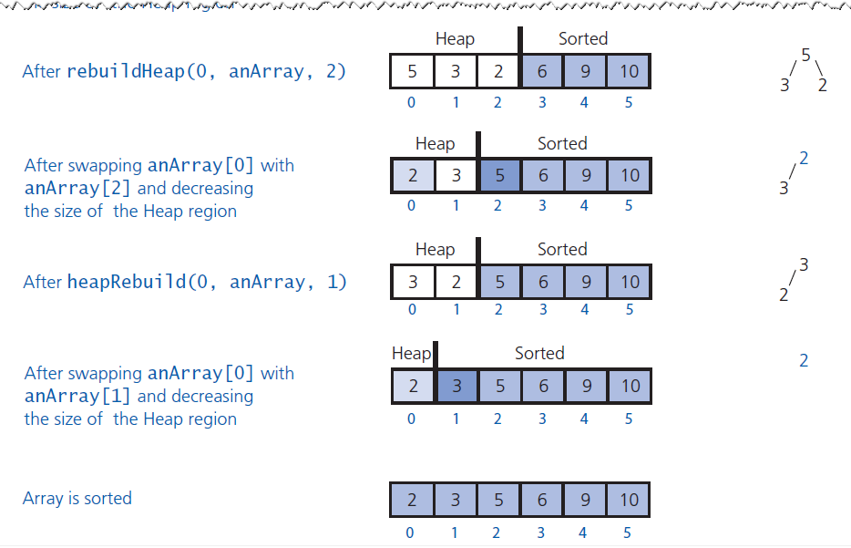
Heap Sort (4 of 4)
Figure 17-11 [Continued]

Slide 35

Copyright

